Slide 1
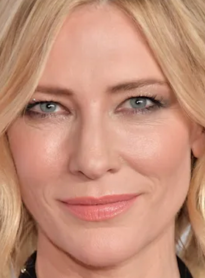
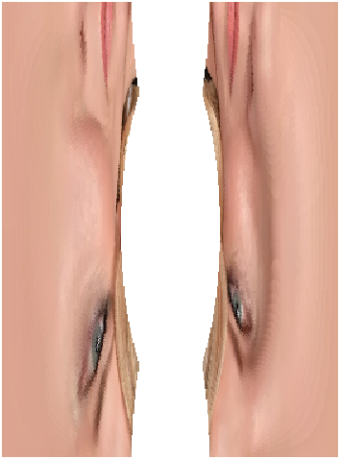
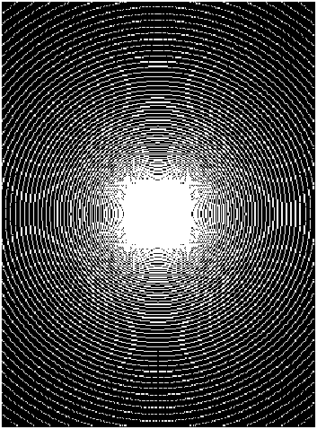
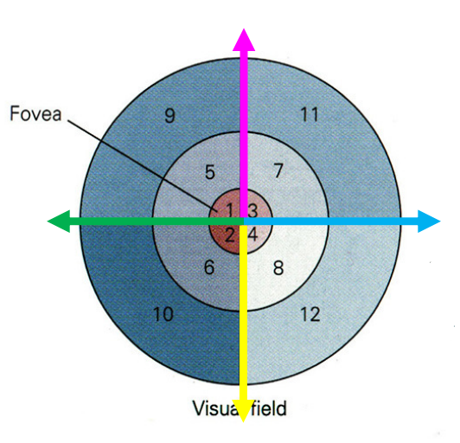
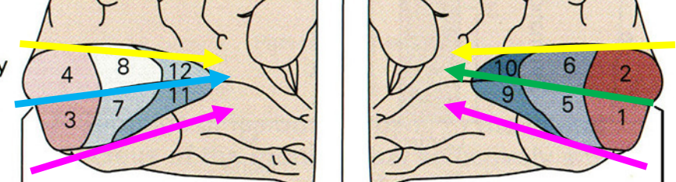
Normal Image Log-Polar Cortical Image Pixel sampling
Foveal dominance: white = pixels that were sampled into log-polar image; more pixels were sampled from the middle
The image is inverted about the origin so top-right quadrant becomes the bottom-left. Additionally, each quadrant is inverted so the middle of the image becomes the outside of the log-polar image

Slide 2

Left V1 Right V1
4
8
12
10
6
2
270° (bottom)
0 (blue) or 180° (green) (both are middle line)
3
7
11
9
5
1
90° (top)
(Inside = higher eccentricity)

Slide 3
-90
0
90
180
270
Left cortex, right visual field
Right cortex, left visual field
Expand log distance axis
4
8
12
10
6
2
Angle
3
7
11
9
5
1
Center/fovea ➔ Periphery
Log(distance)
Rotate to stack magenta arrows

Slide 4
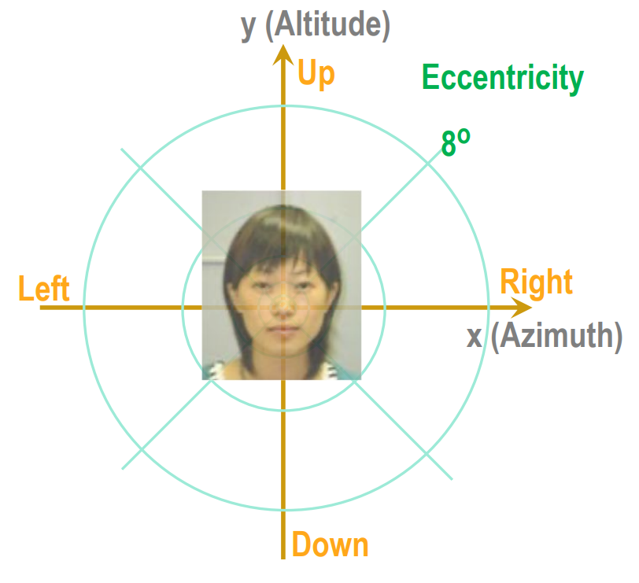
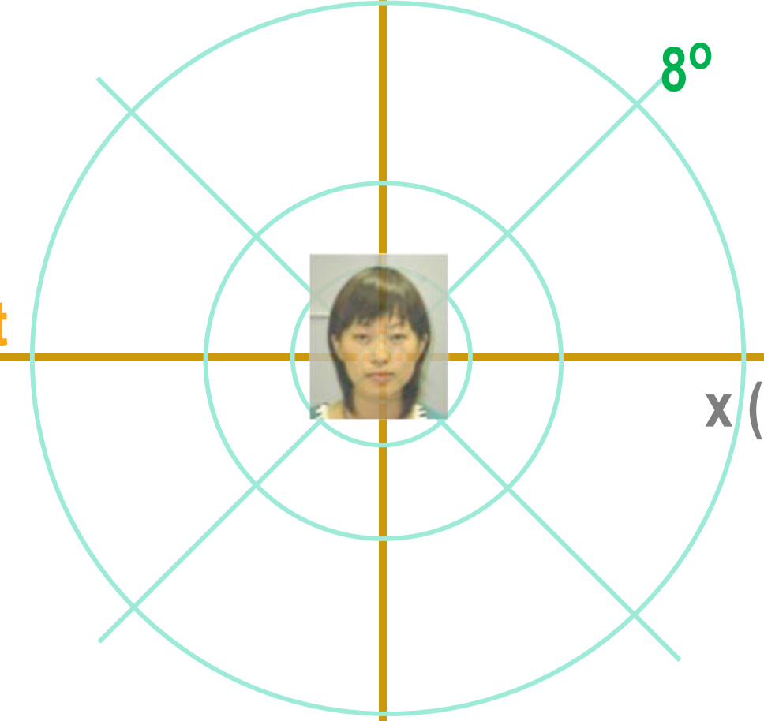
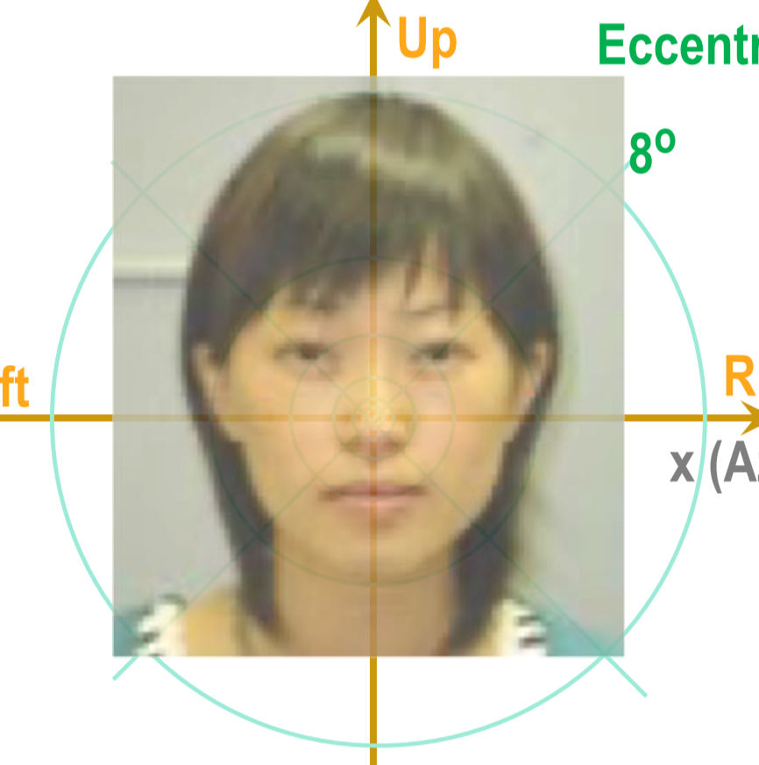
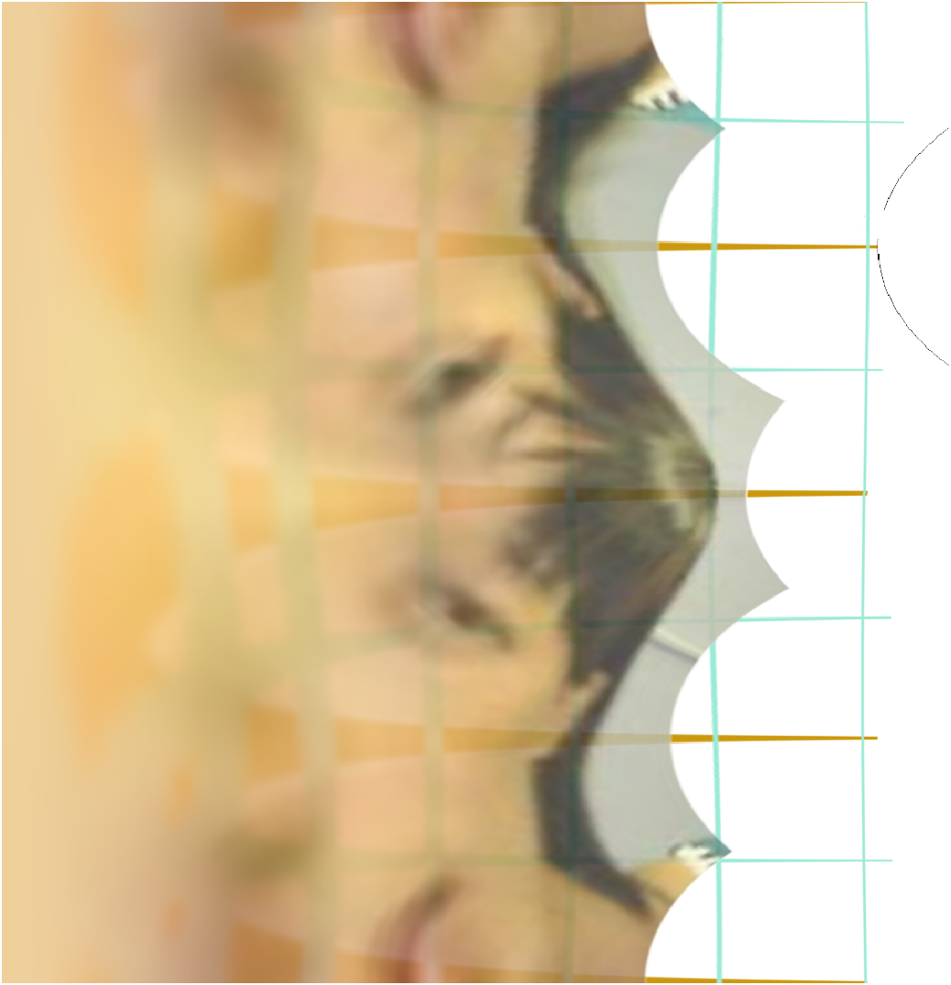
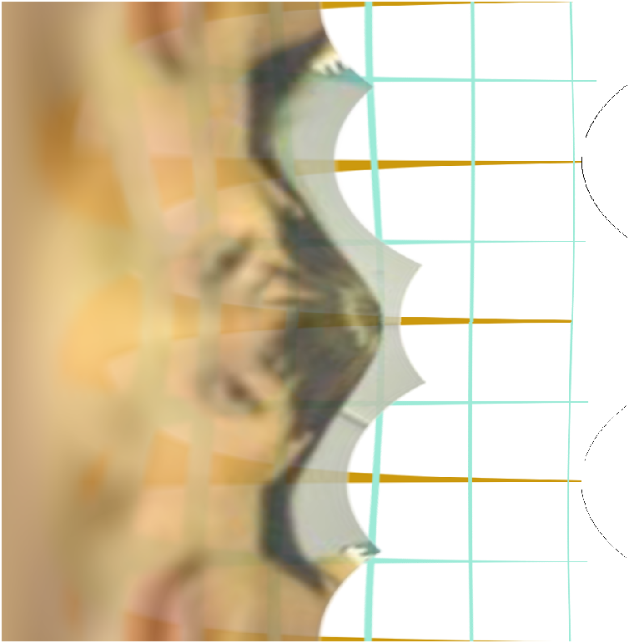
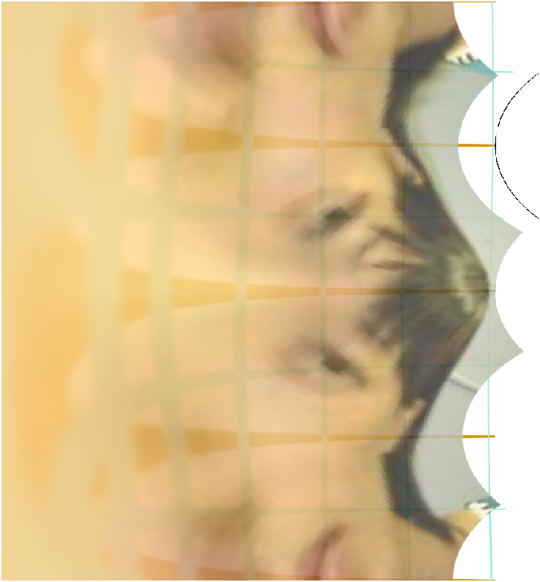
-90
0
90
180
270
Rescaling the image converts to a horizontal translation in the visual cortex – the cortical pattern does not

Slide 5
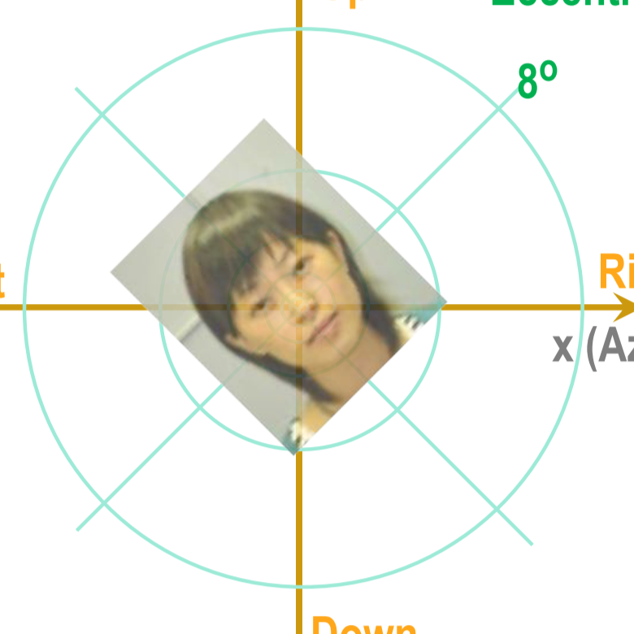
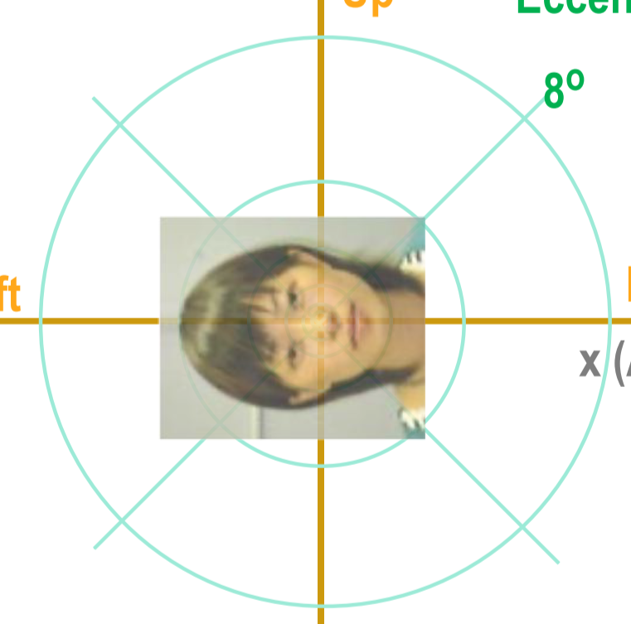
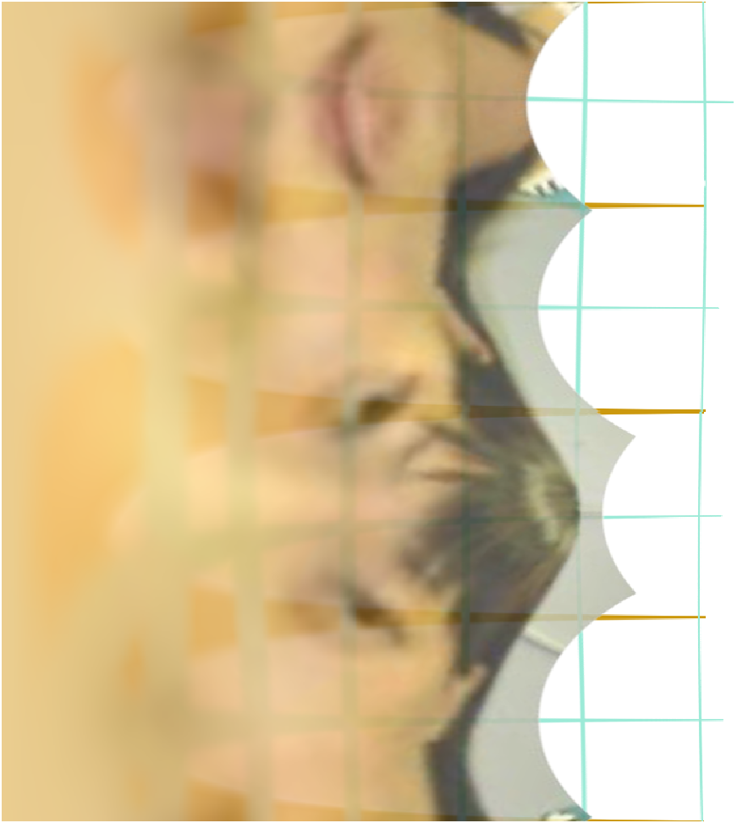
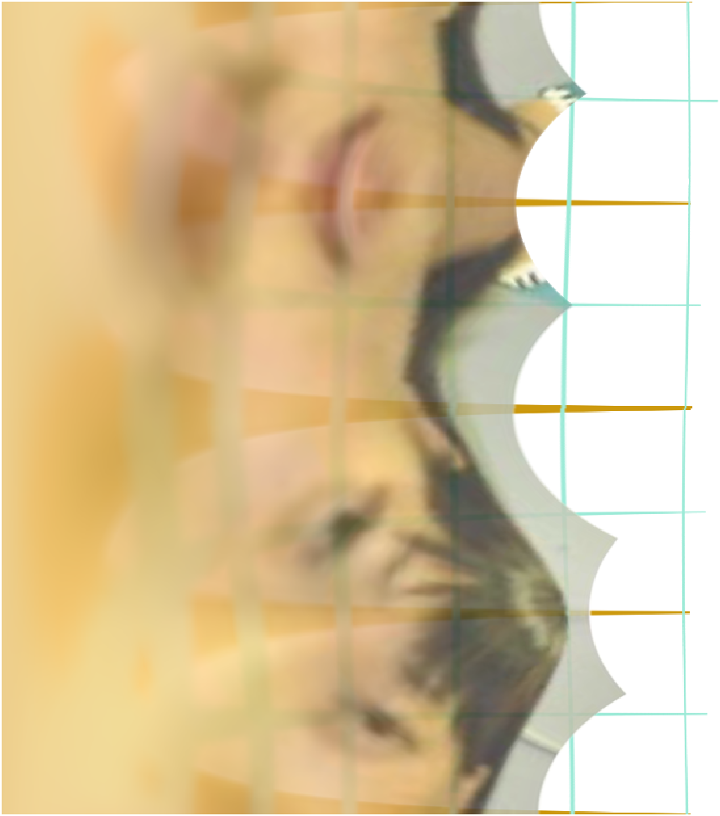
CC = down
-90
0
90
180
270
-90
0
90
180
270
-90
0
90
180
270
Right eye
Left eye
Rotating the image converts to a vertical translation in both halves of the visual cortex – the cortical pattern does not change, assuming the brain can combine information from the left and right visual fields.

Slide 6
Memorized Face

Slide 7
Memorized Face

Slide 8
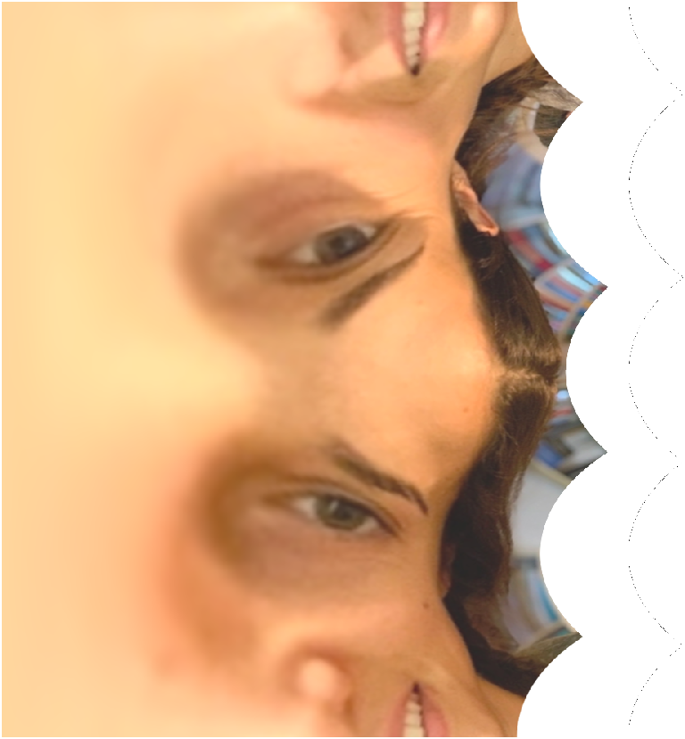

Memorized Face

Slide 9
Double Sized Face

Slide 10
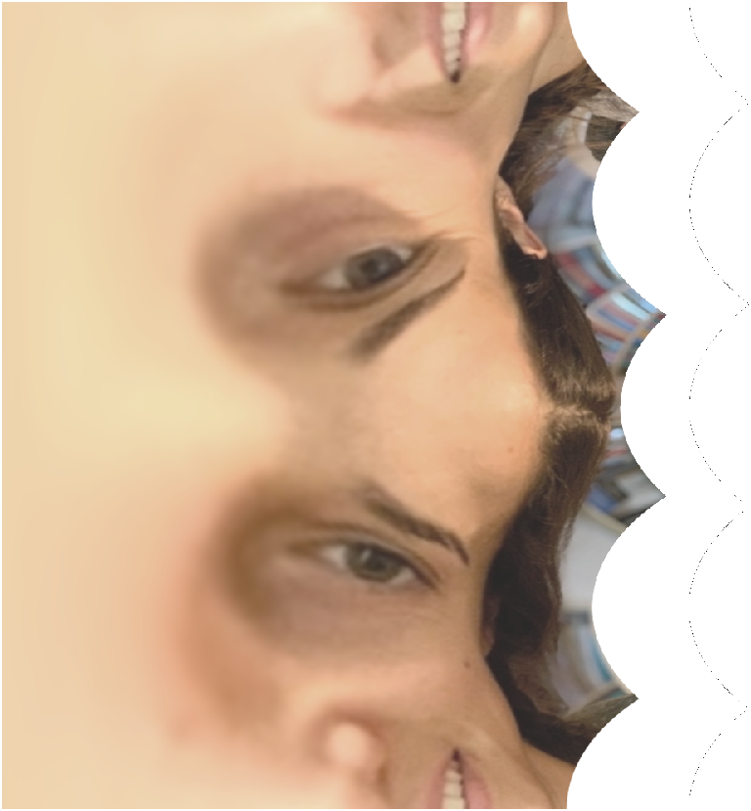
Half Sized Face

Slide 11
Memorized Face

Slide 12
45 degrees counterclockwise

Slide 13
90 degrees Clockwise

Slide 14
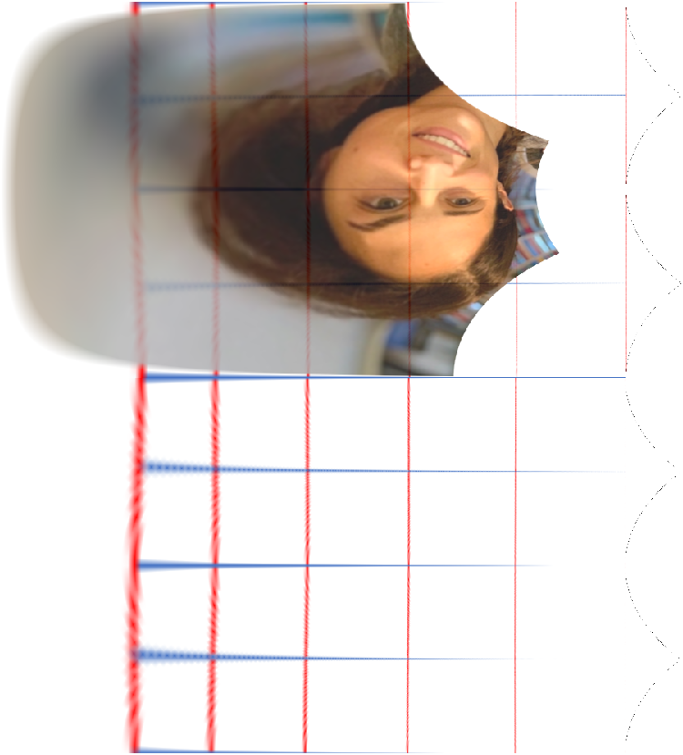
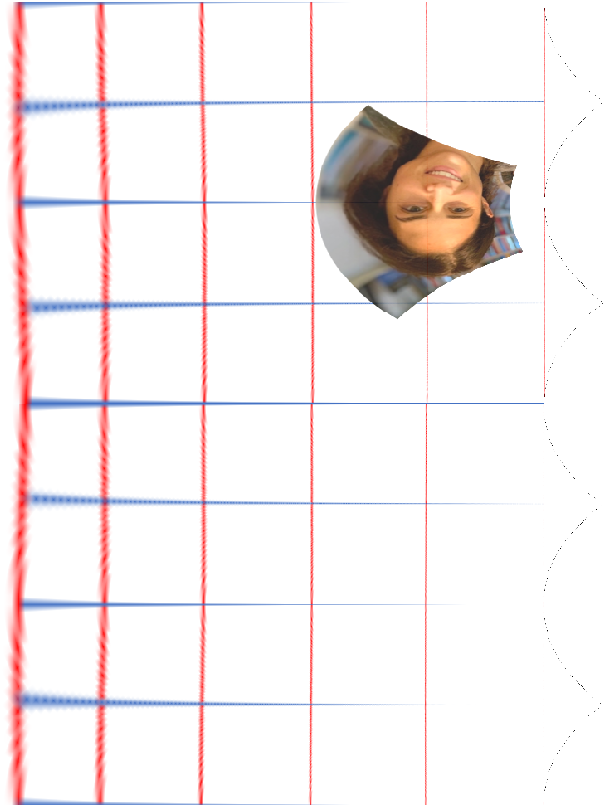
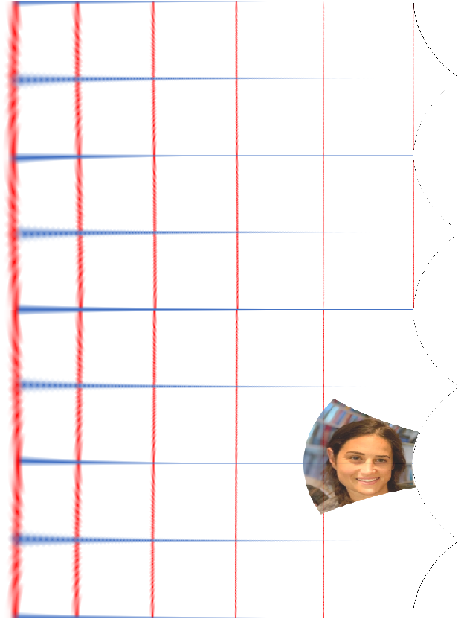
Eccentricity

Slide 15
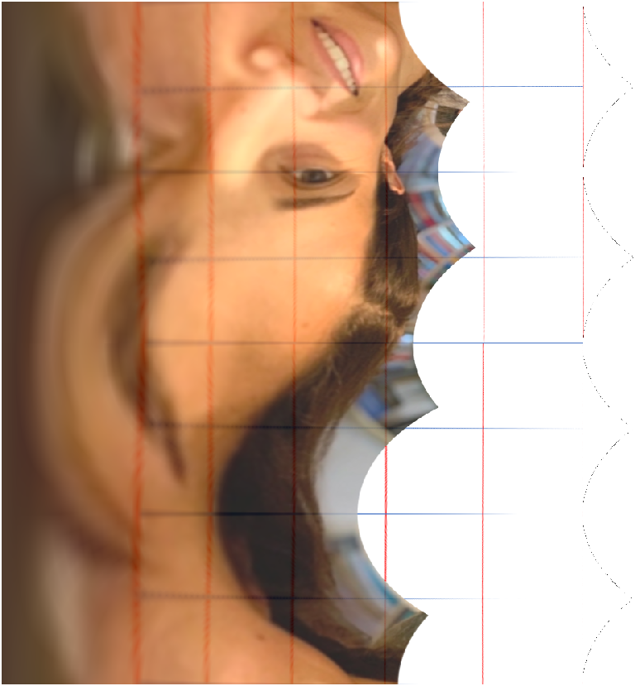
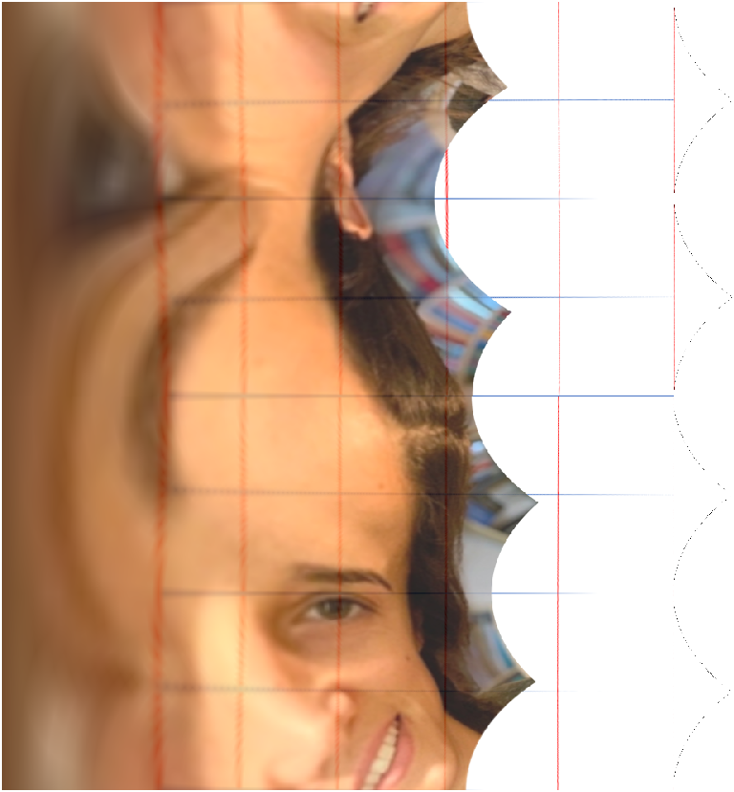
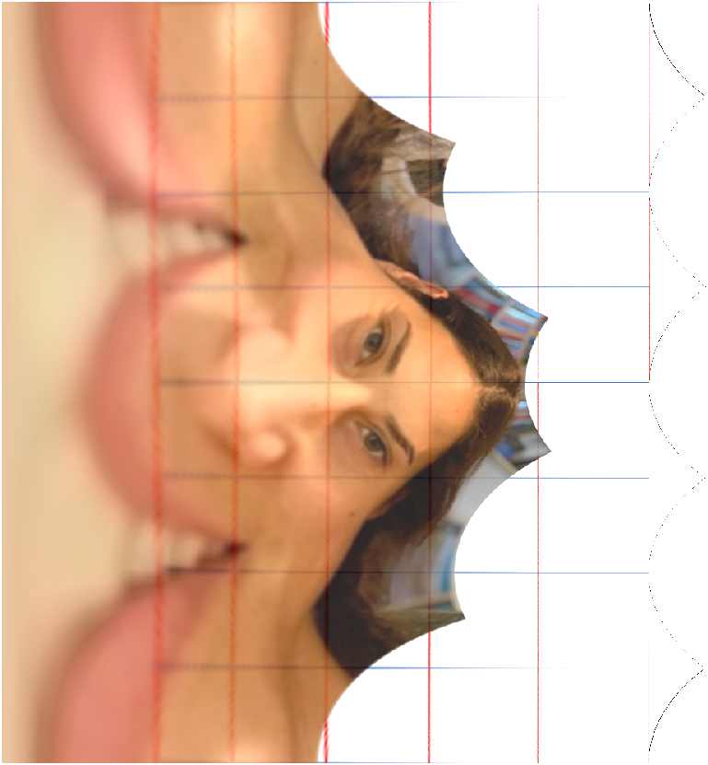
Focusing on Key features

Slide 16
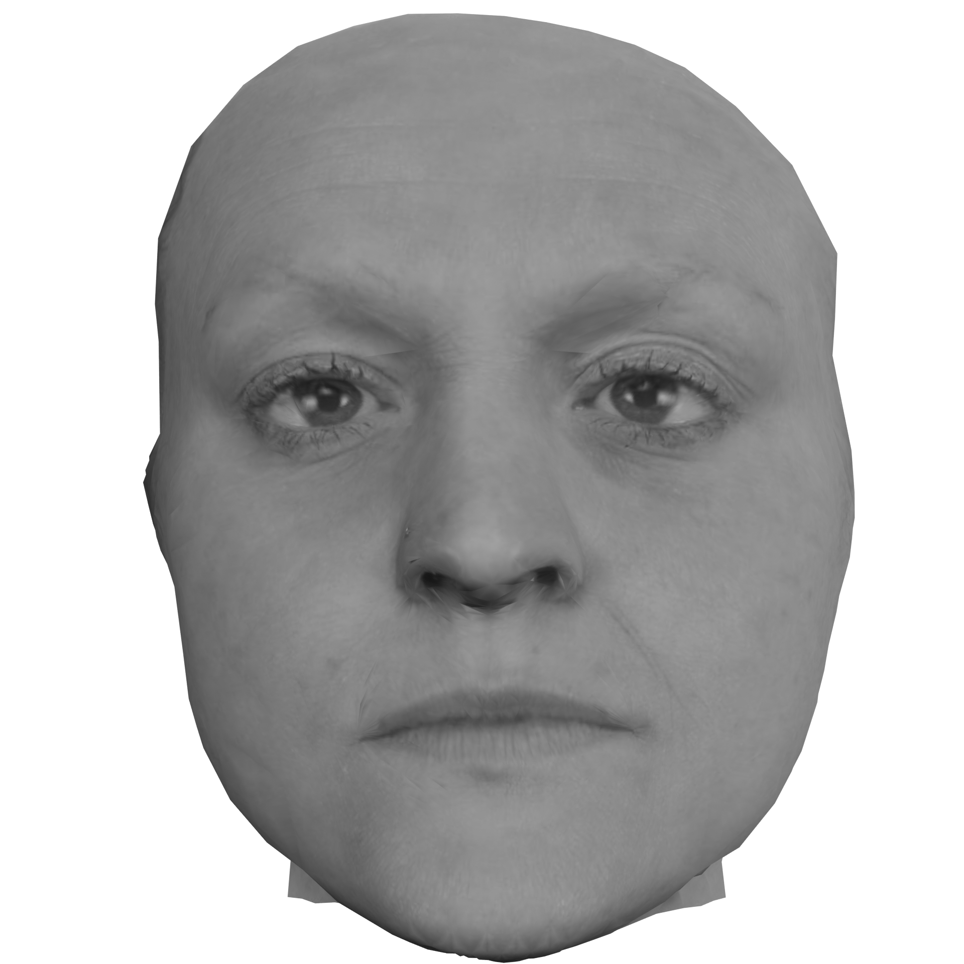
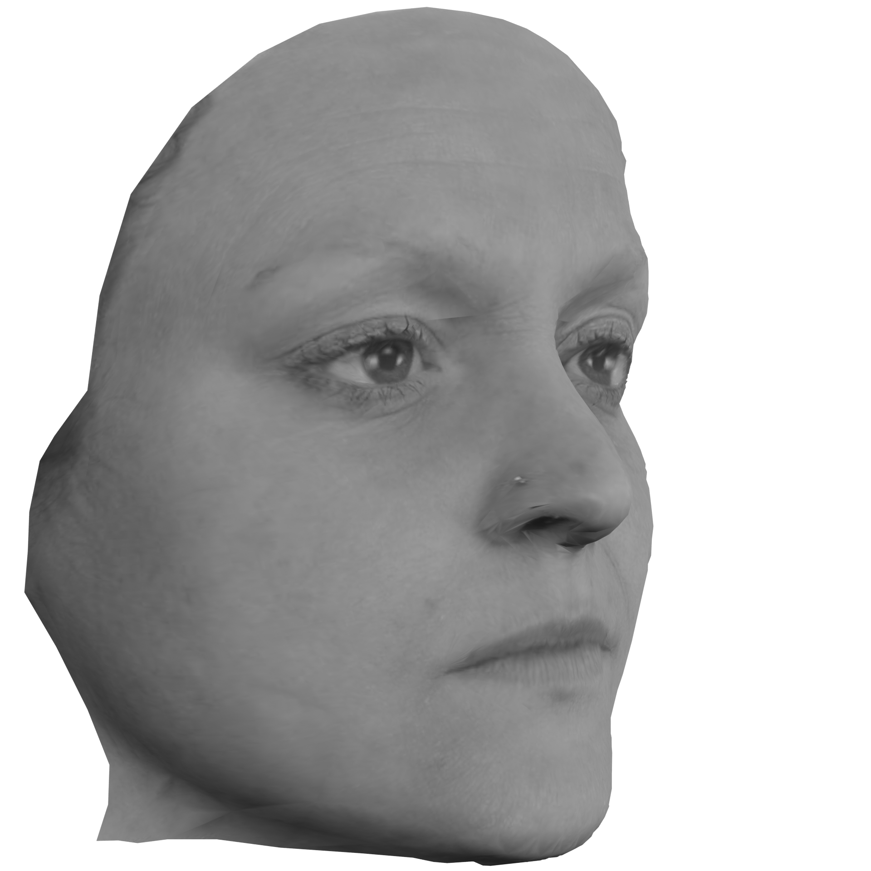
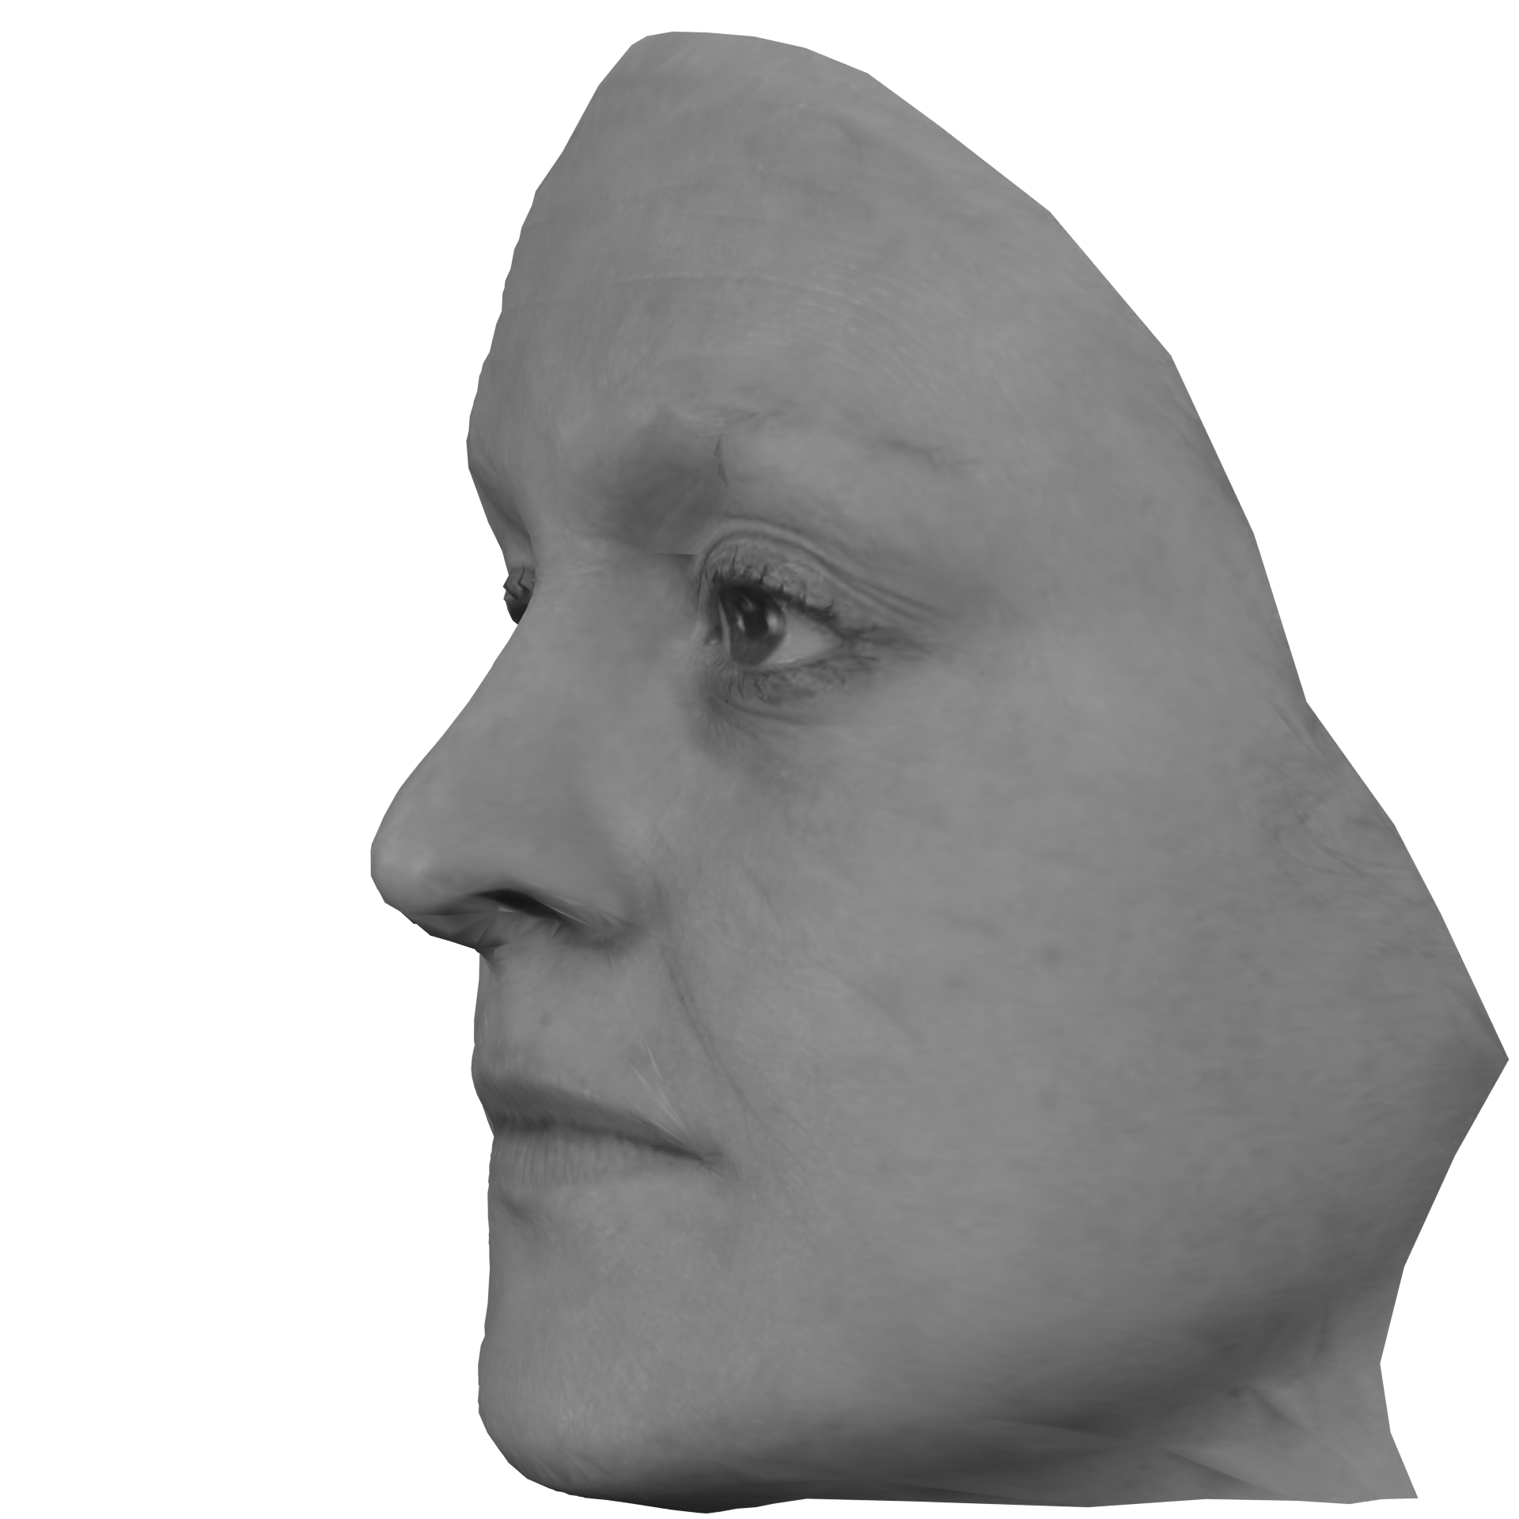
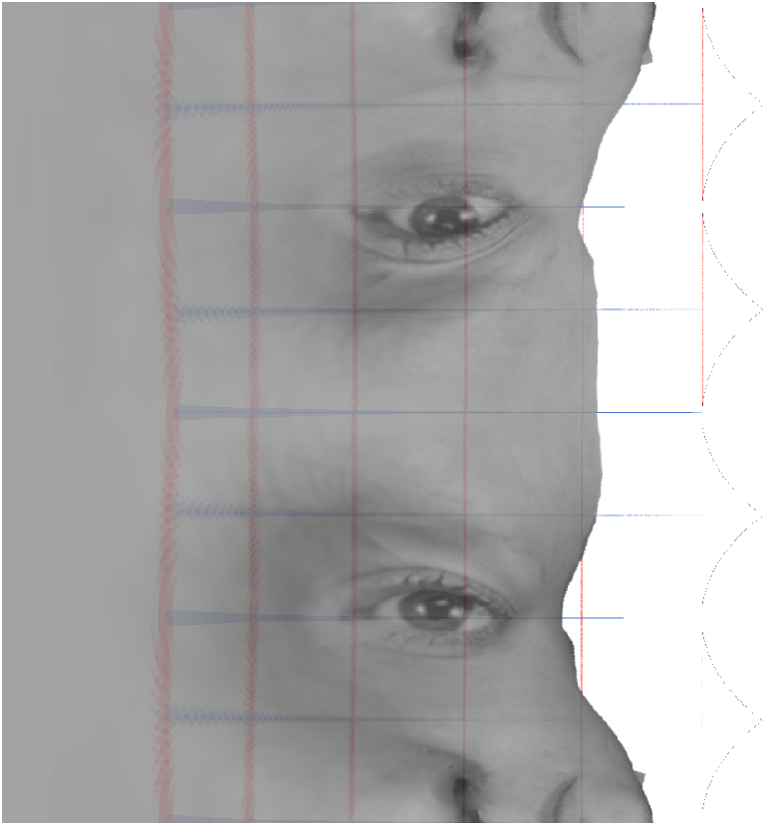
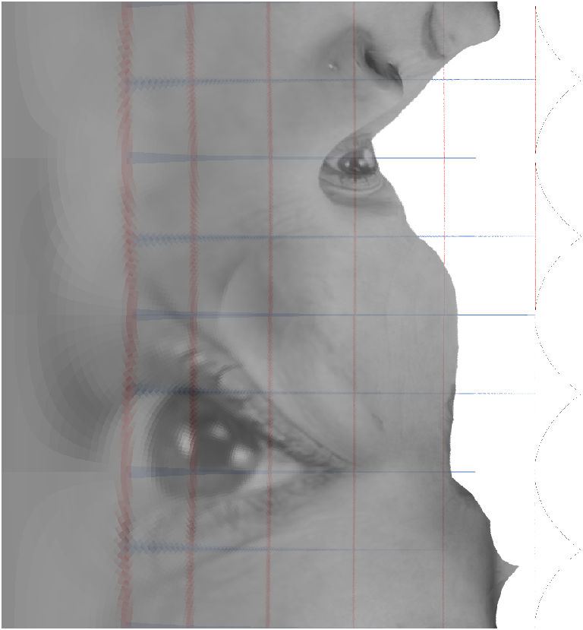
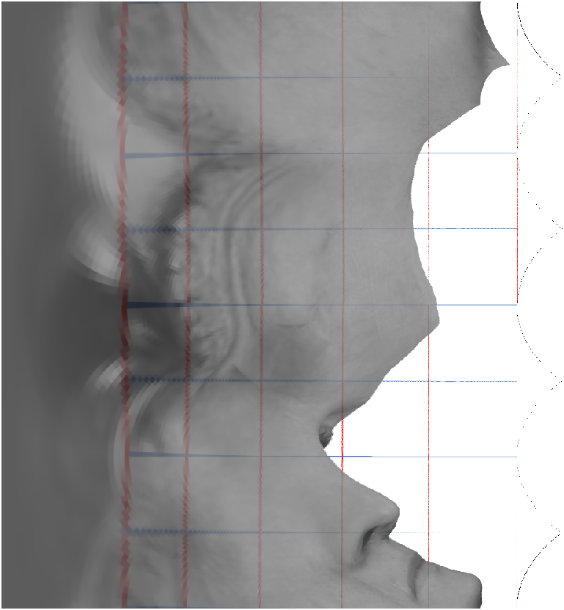
Yaw Rotation

Slide 17
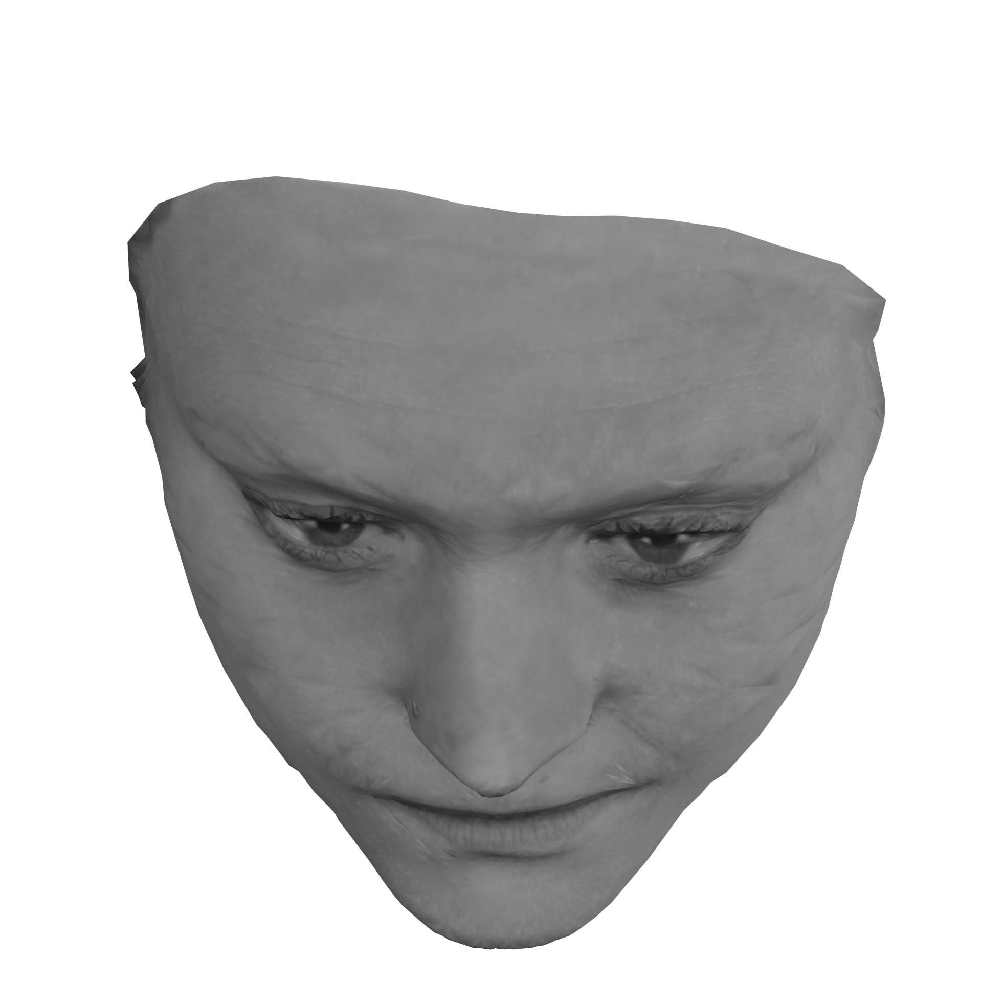
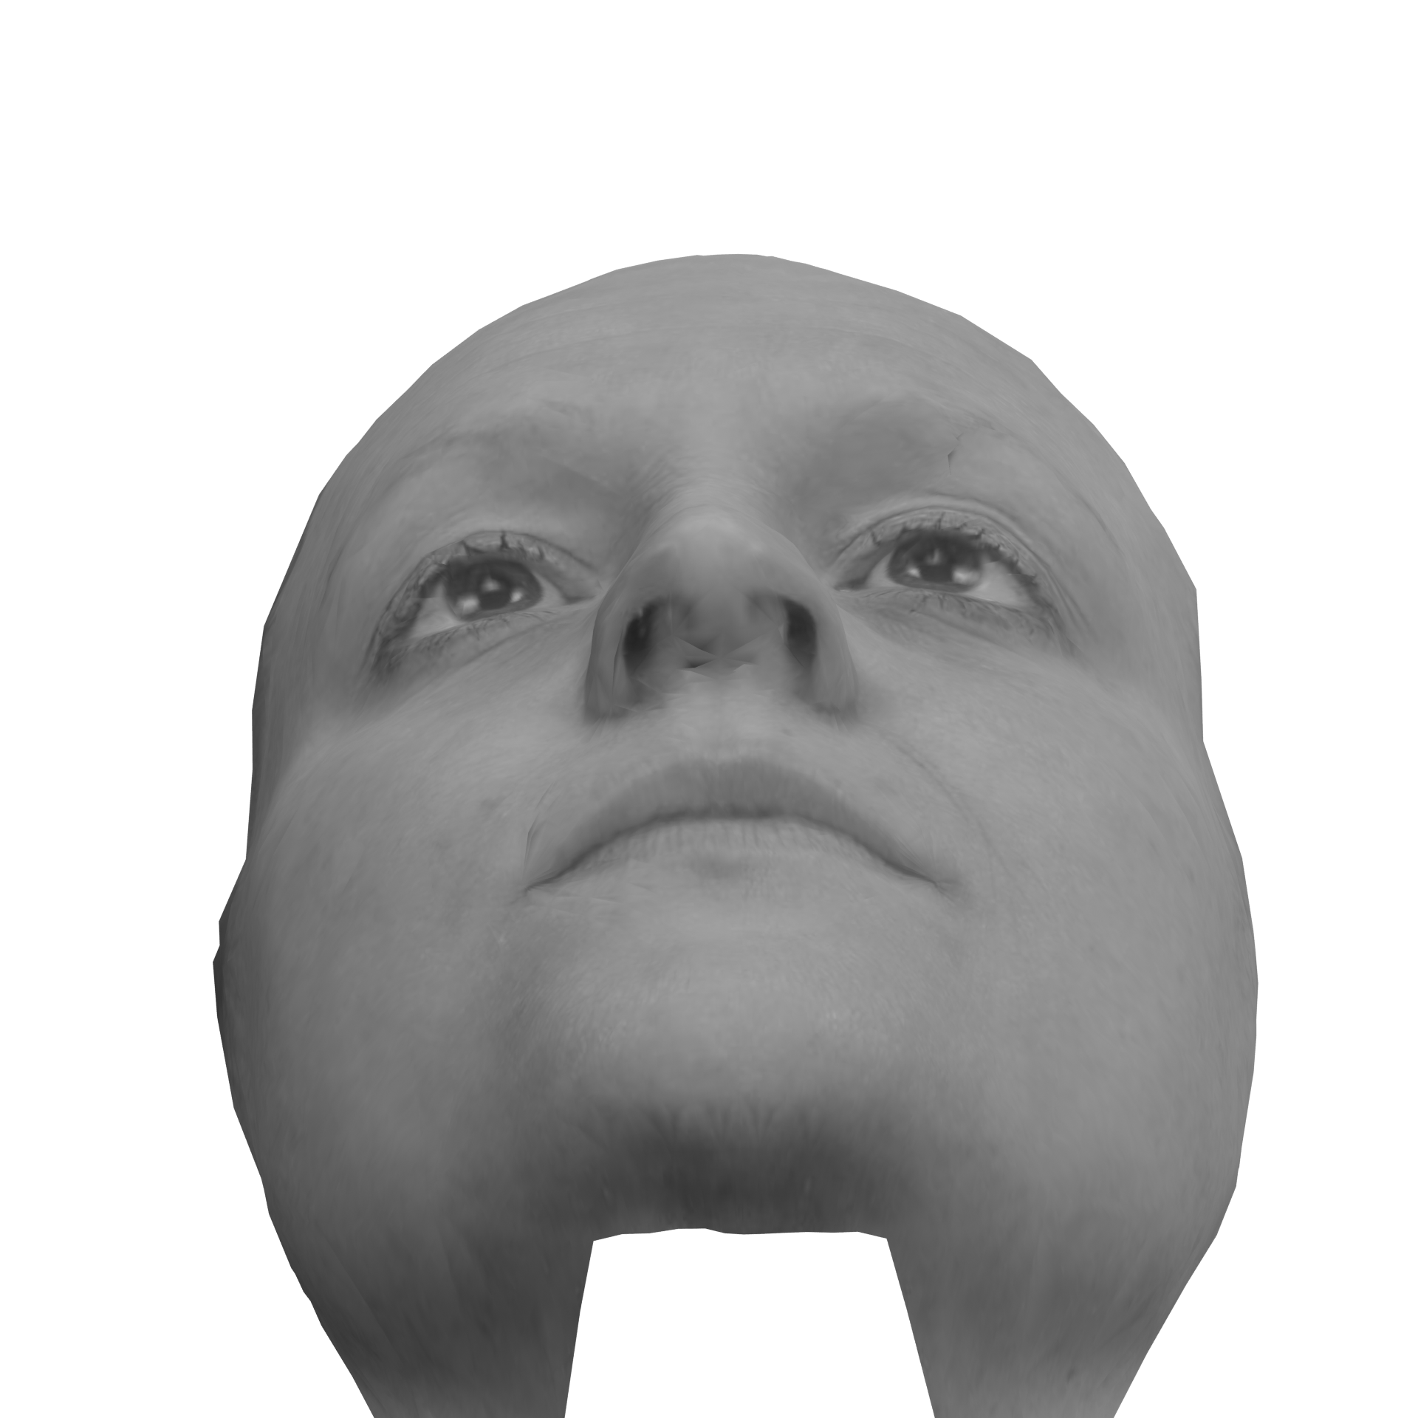
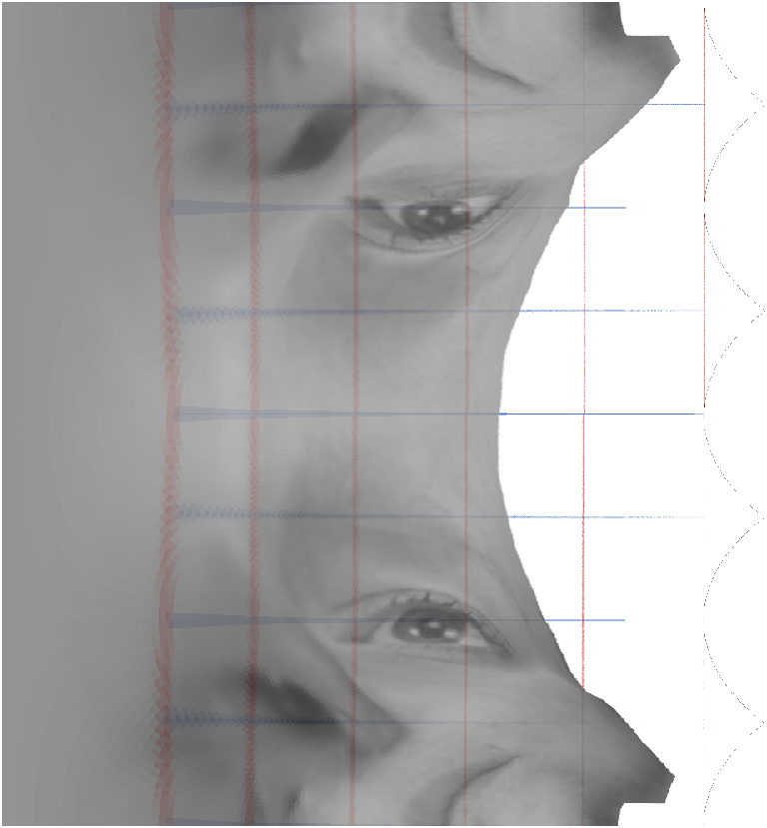
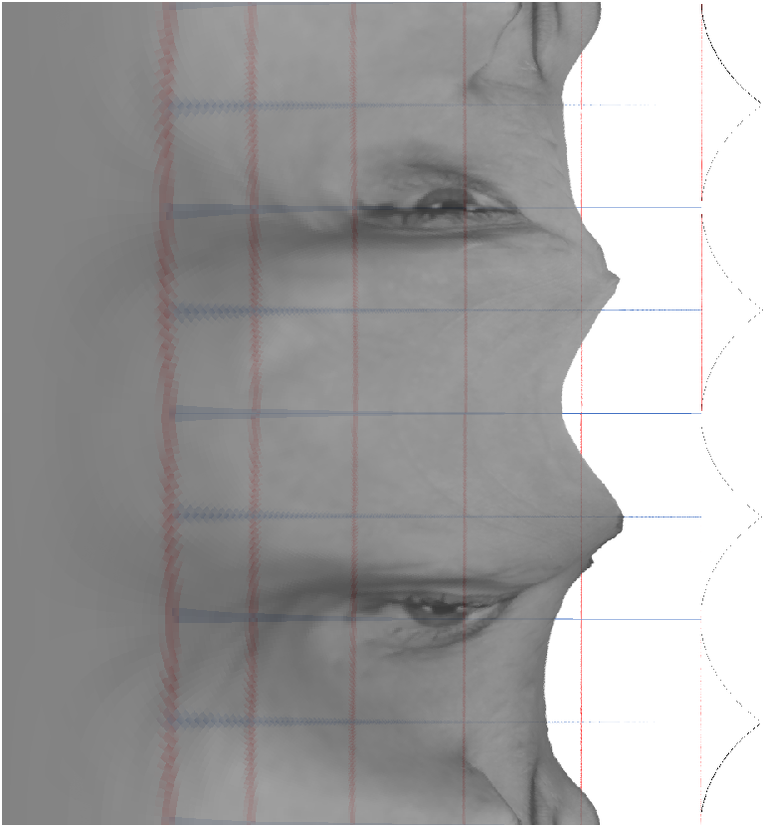
Pitch Rotation

Slide 18
Memorized Face

Slide 19
2x scale and 90 degrees Clockwise

Slide 20
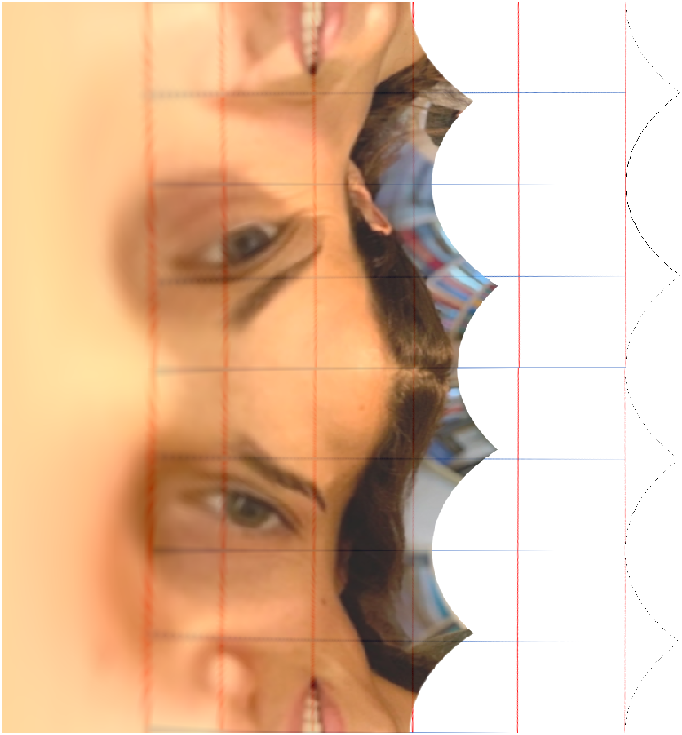
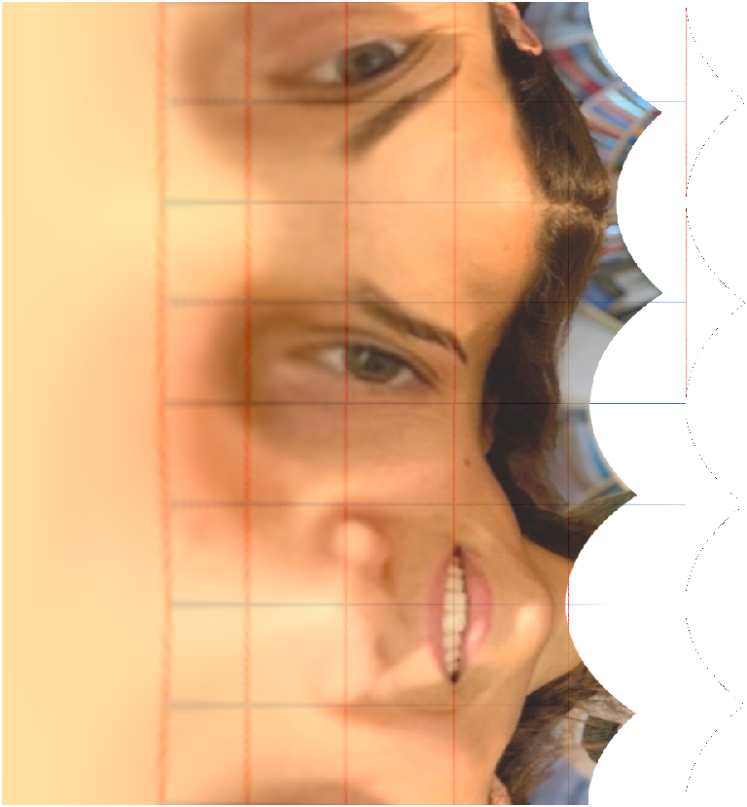
0 degrees CC
2x Scale 45 degrees CC
Serial Processing: Vertical and horizontal translations are separate (unknown order) and additive
Parallel Processing: Both translations are simultaneous = faster translation is masked
Superposed Processing: Superposition of vectors leads to a single direct translation

Slide 21

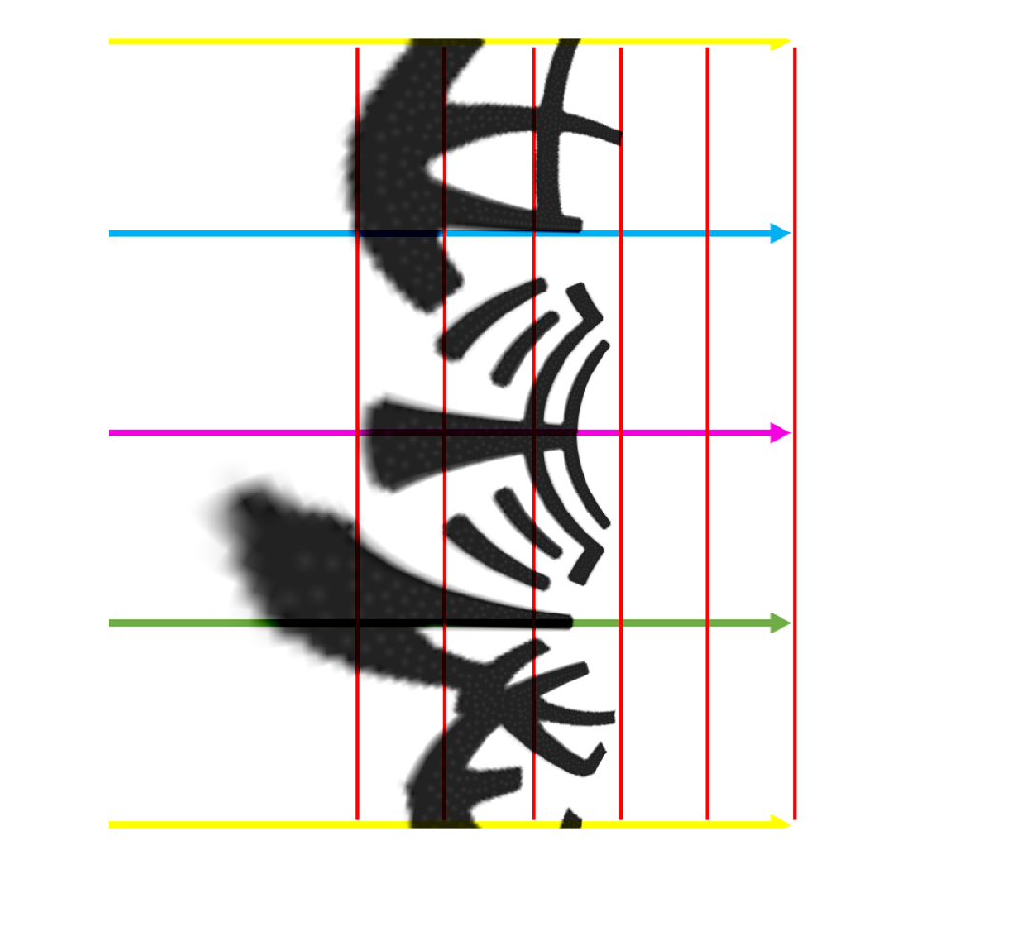
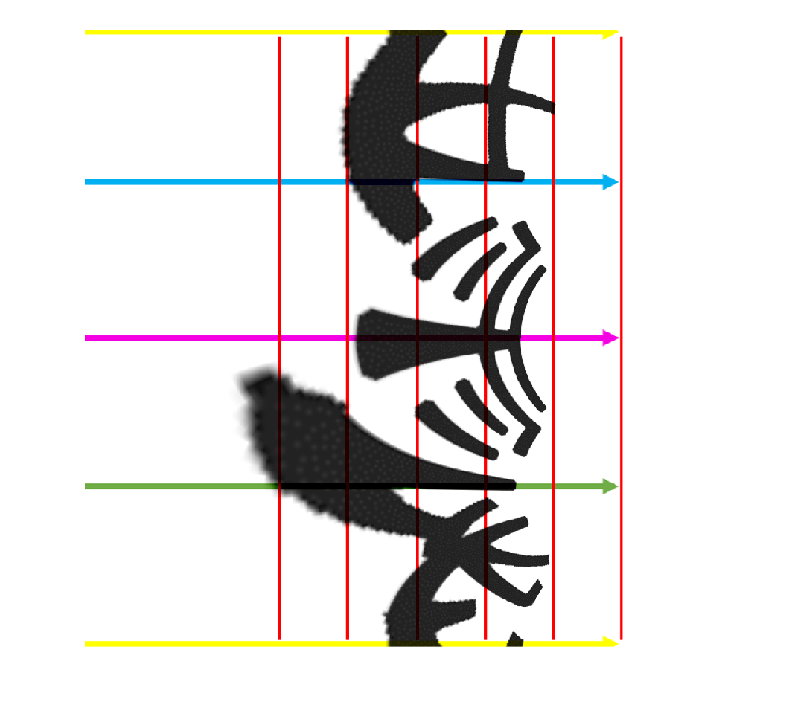
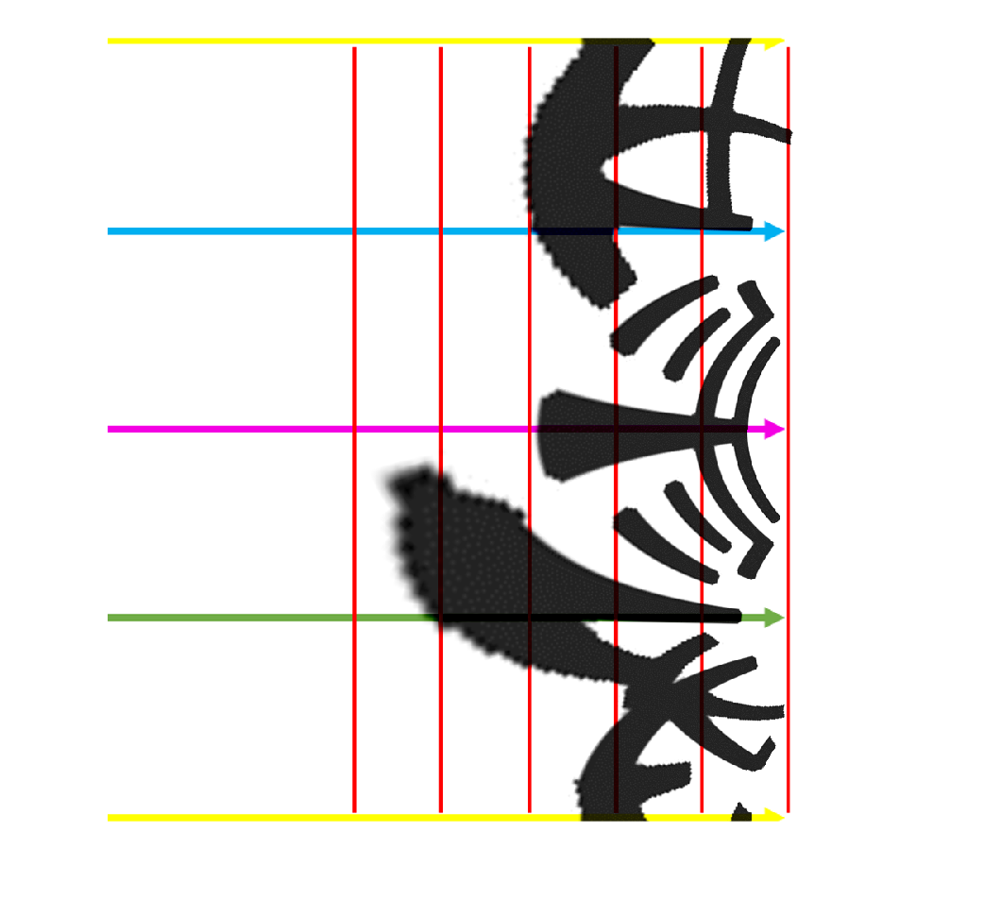

Slide 22
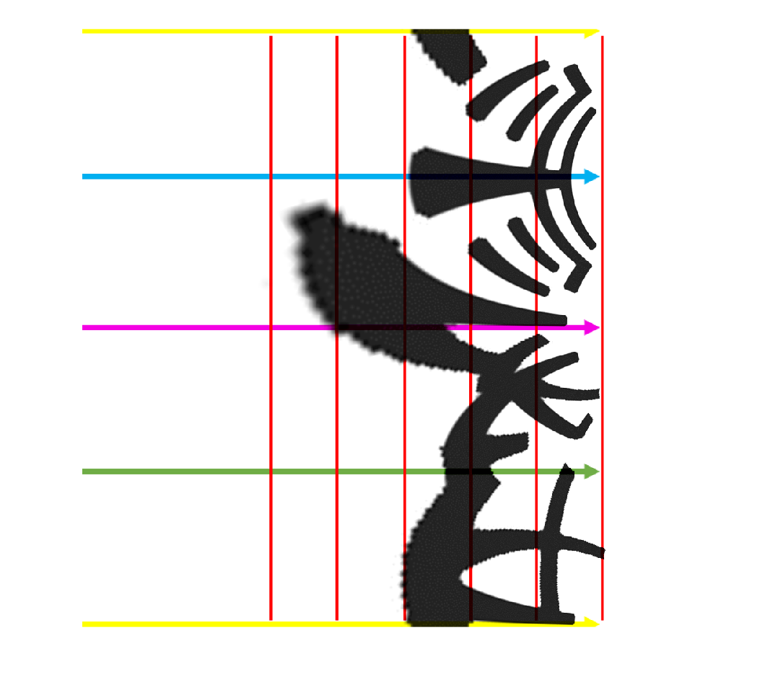
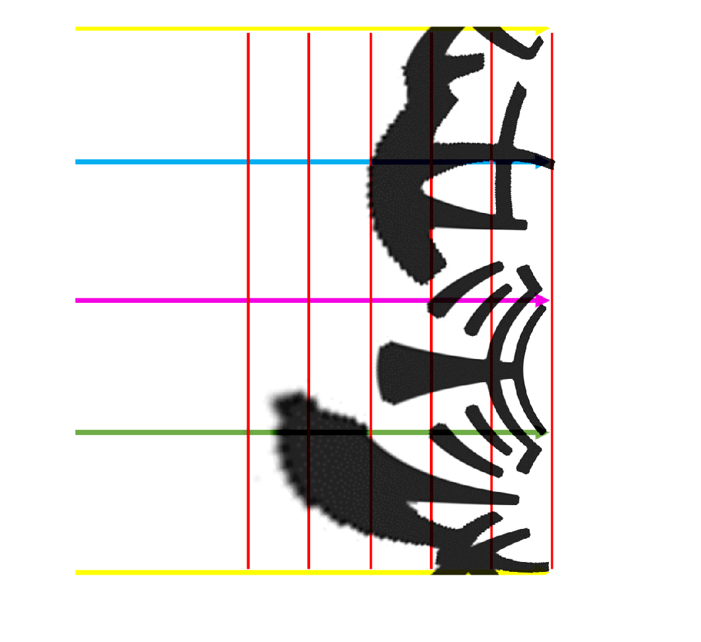

Slide 23

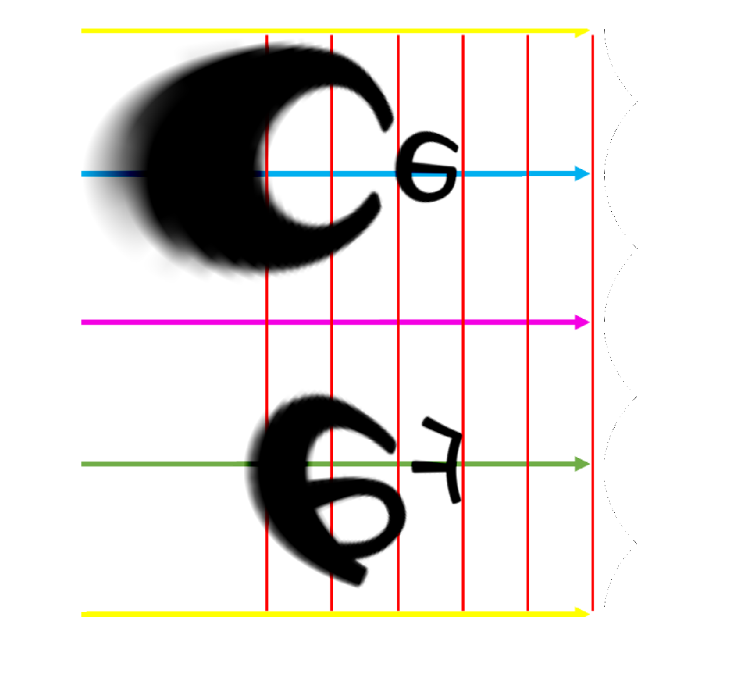
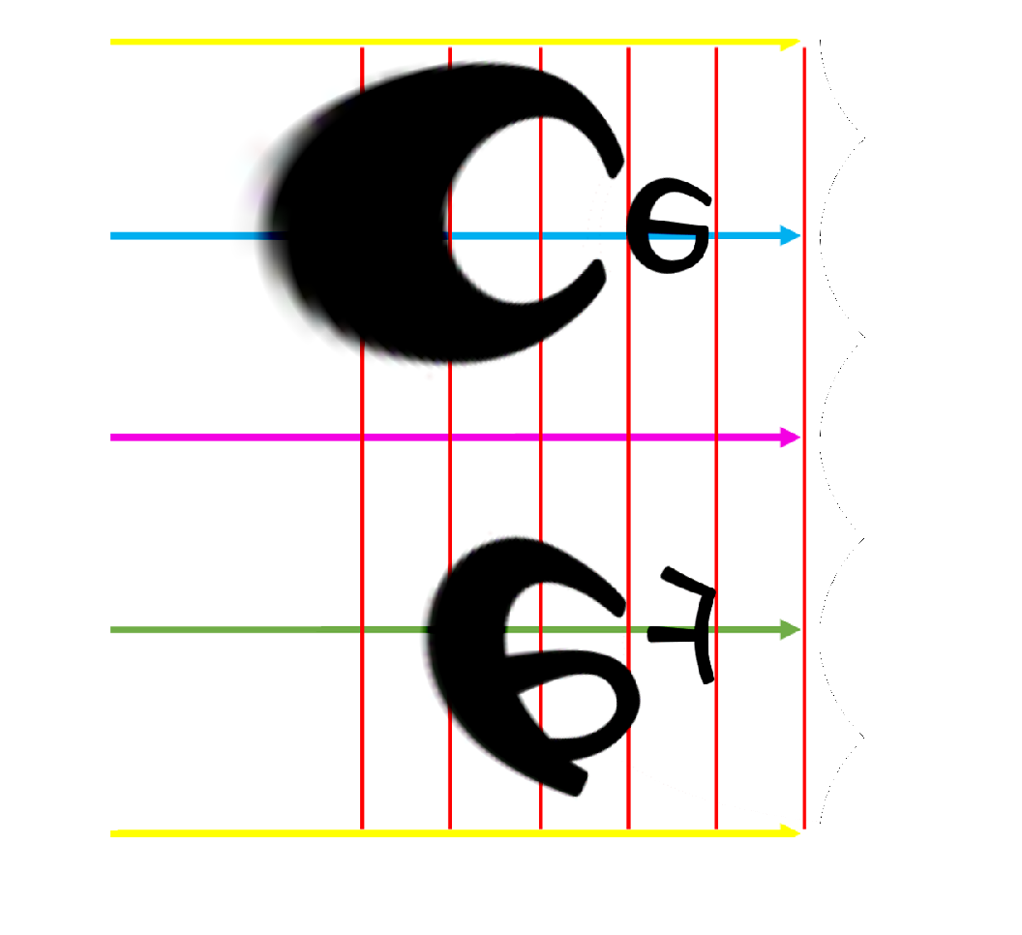
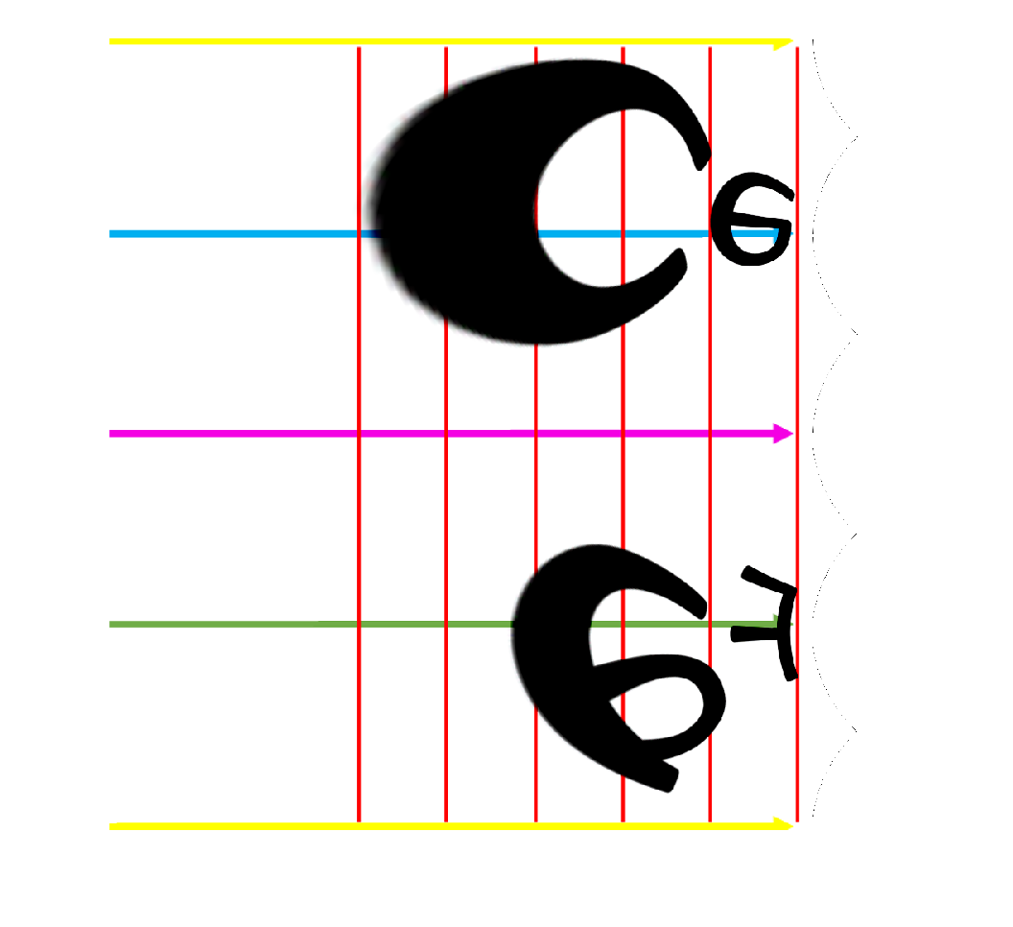

Slide 24
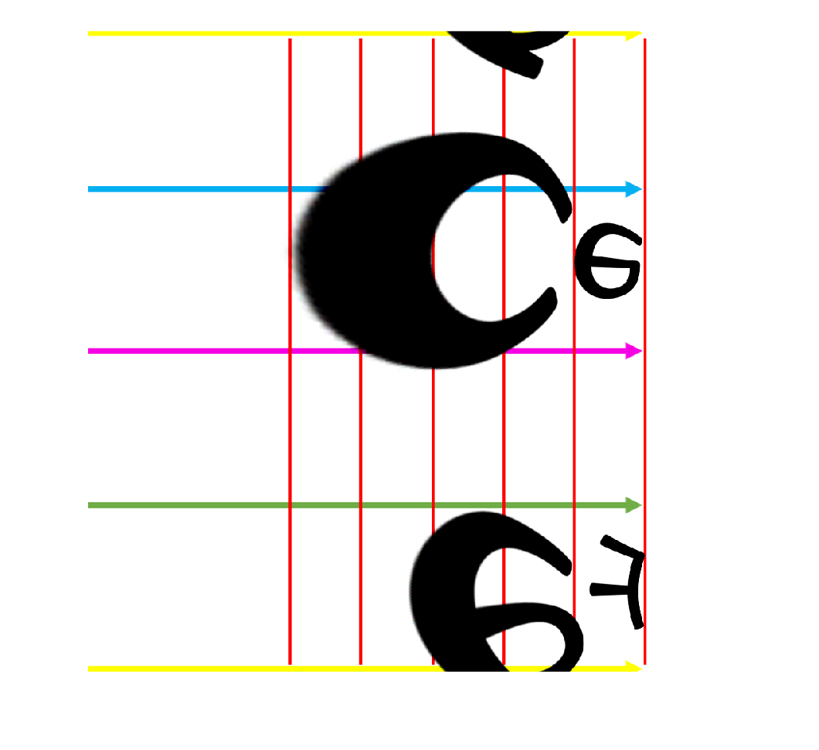
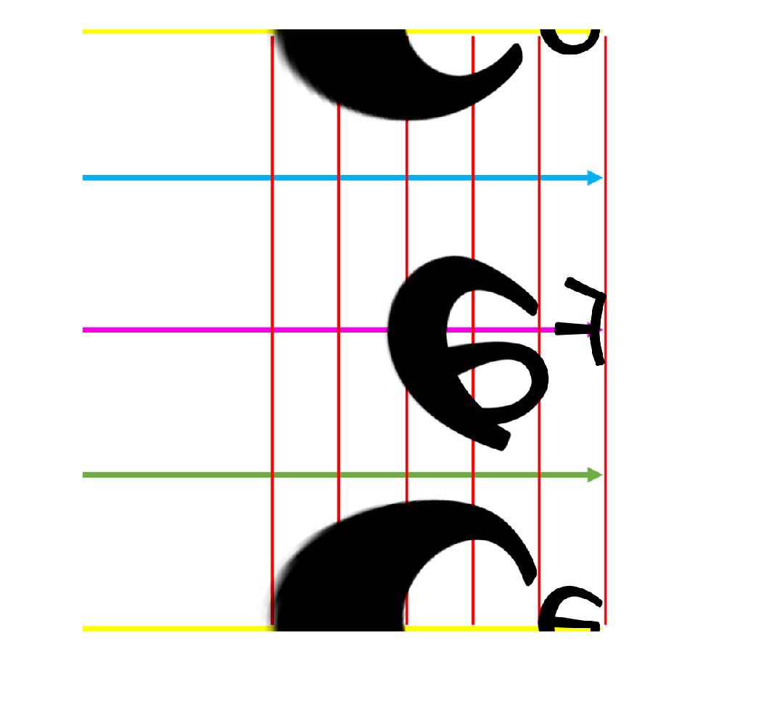

Slide 25
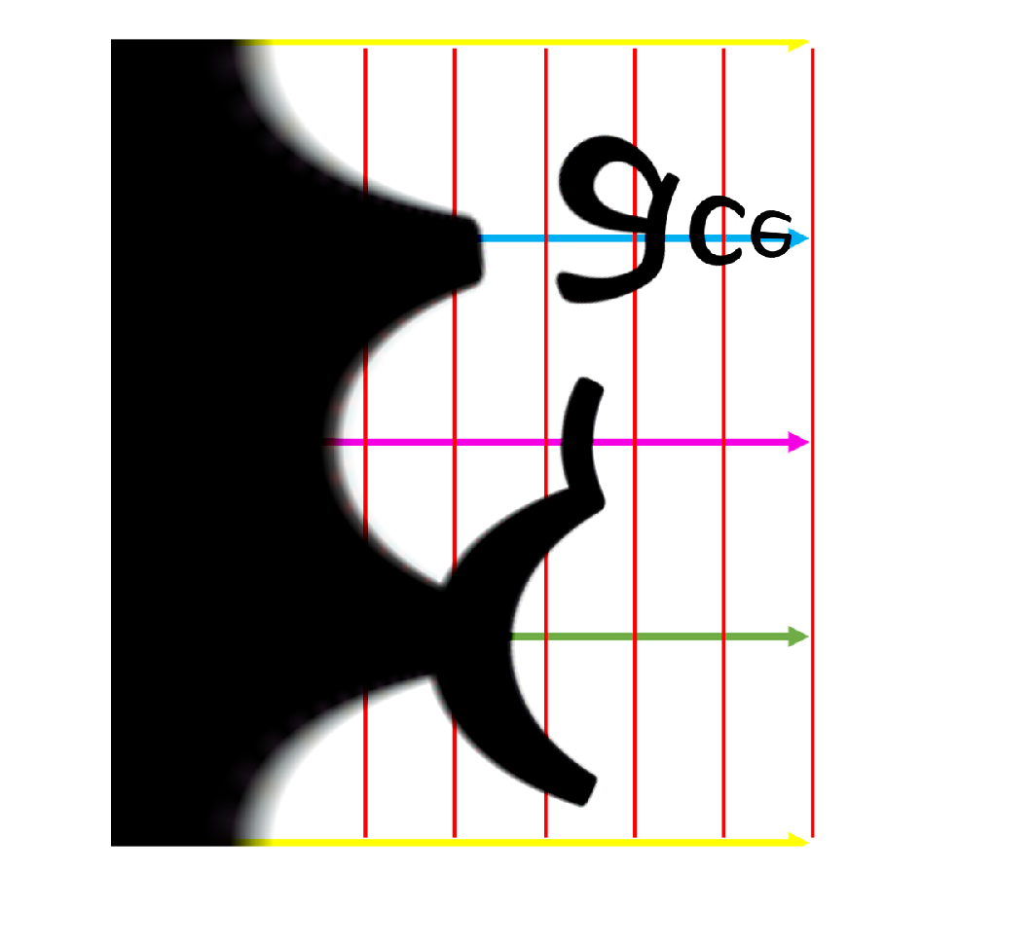
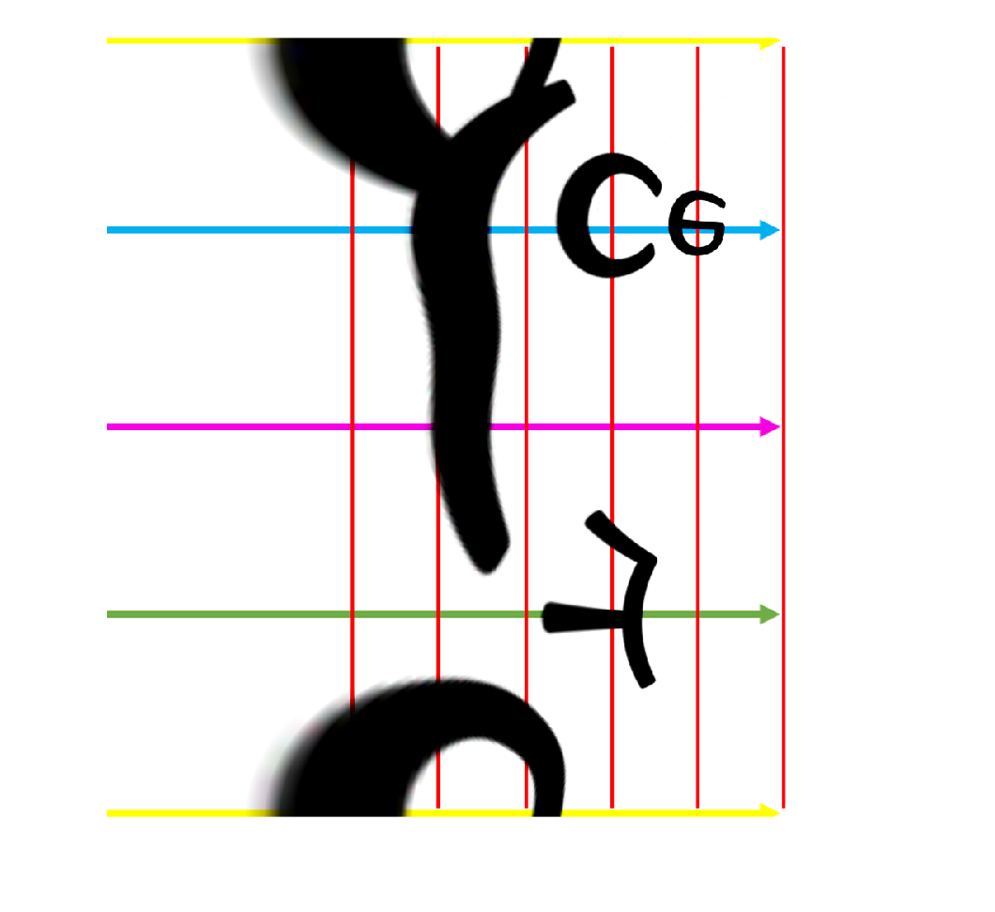
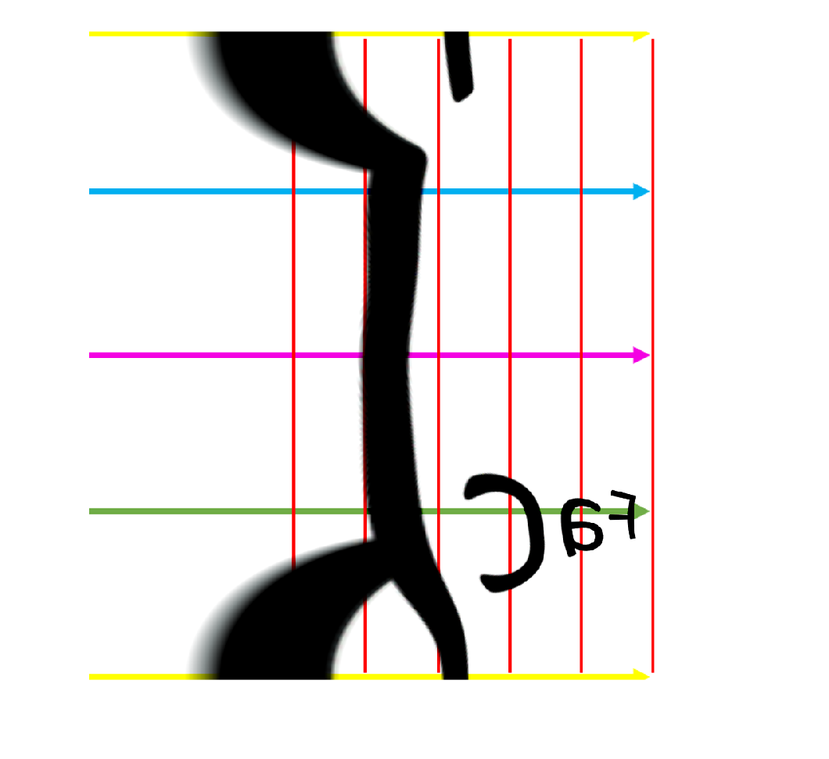

Slide 26
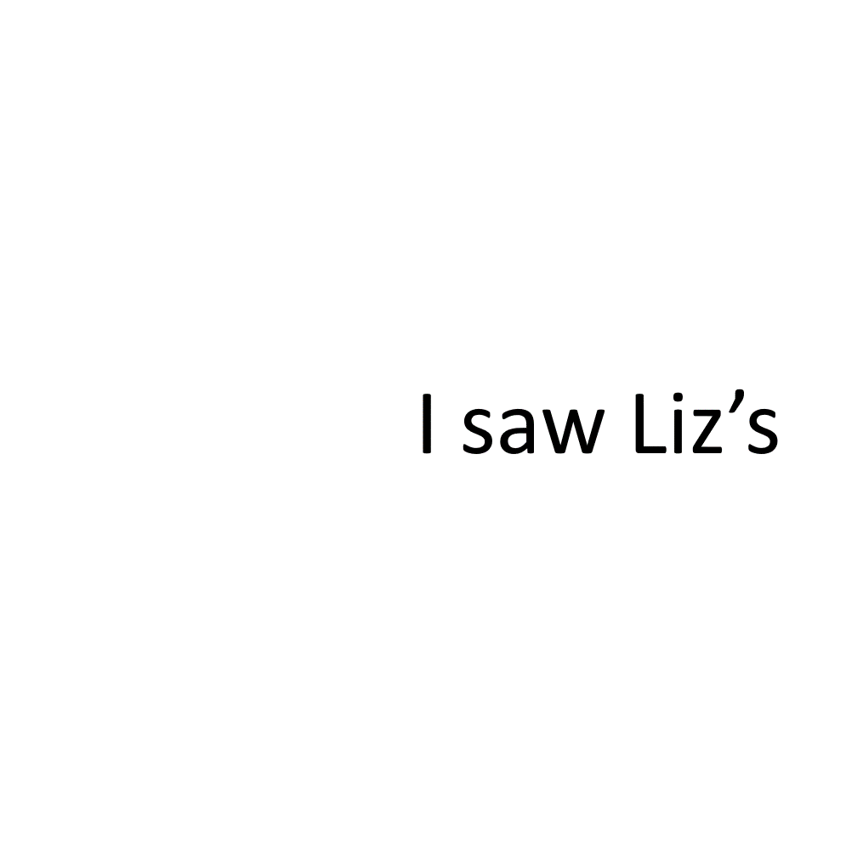


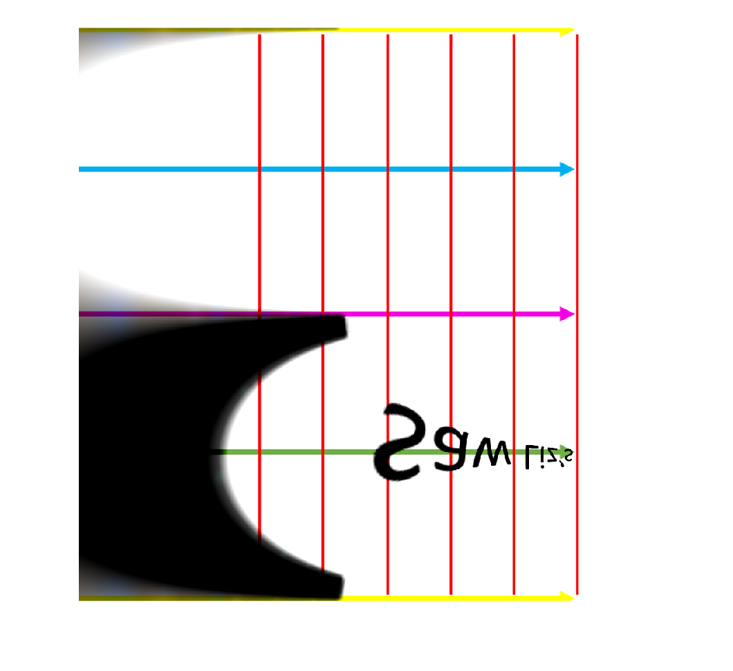



Slide 27



